Slide 1

What is a computer?

Slide 2

1 Bit

Slide 3
Since 1 bit can only be used to encode 2 distinct pieces of information, we need more bits to store some meaningful information.
1 Byte = 8 bits

Slide 4
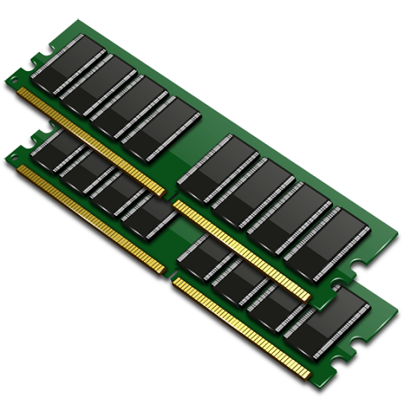
….. ~ 16 billion bytes
16gb of RAM

Slide 5
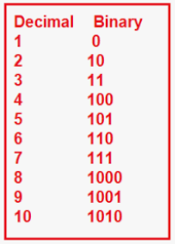

Numbers to Binary

Slide 6
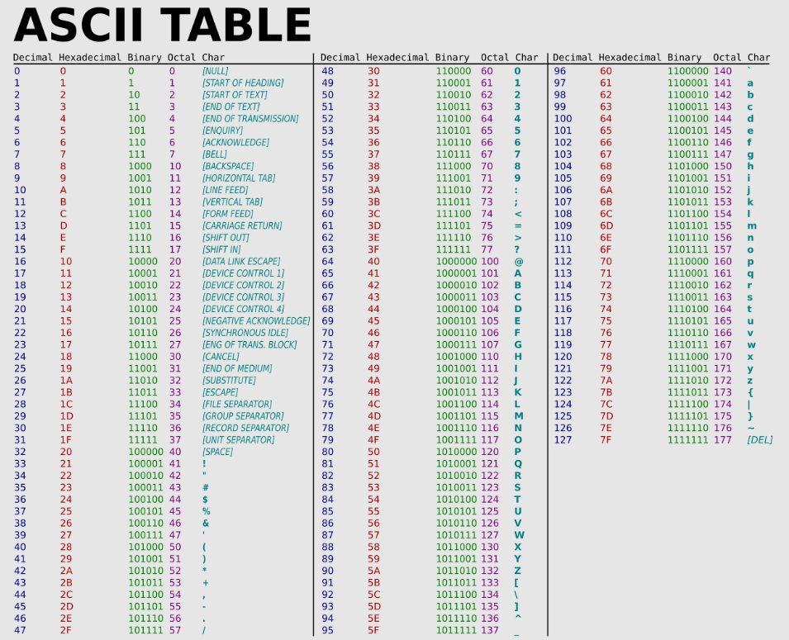
Text to Binary

Slide 7
Hello!
01001000 01100101 01101100 01101100 01101111 00100001

Slide 9
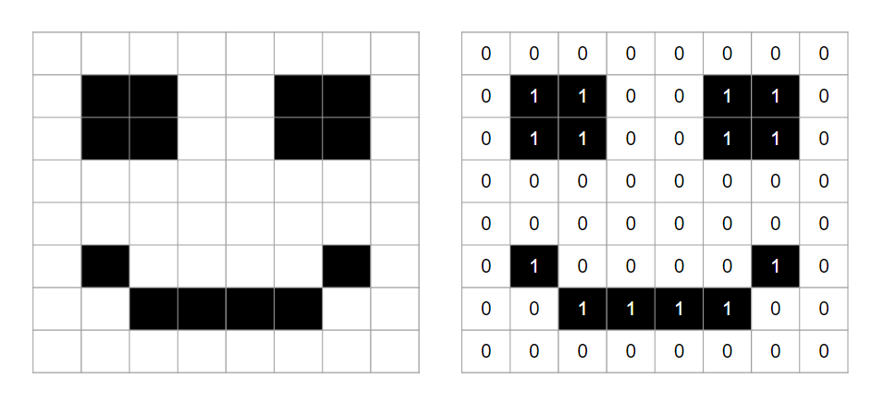
Images to Binary

Slide 10

The dilemma of how to interpret a series of bytes
01000001
Is this an A or the number 65??
To resolve this dilemma, we can start storing meta data, which is information about information in the form of data types

Slide 11
Data types can also help us specify the amount of space on memory to take to store certain information

Slide 12
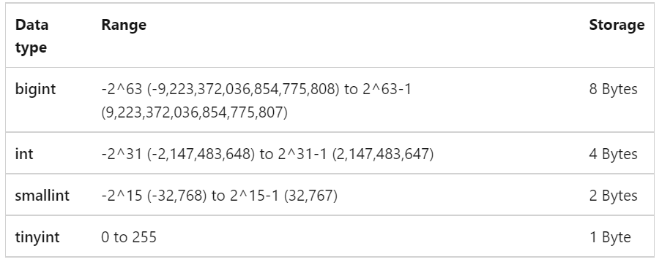

Slide 13
Types of memory
Hard drive / Secondary memory
RAM / Primary memory
Loading and saving…

Slide 14
CPU

Slide 15
Compiler vs. Interpreter

